Slide 1
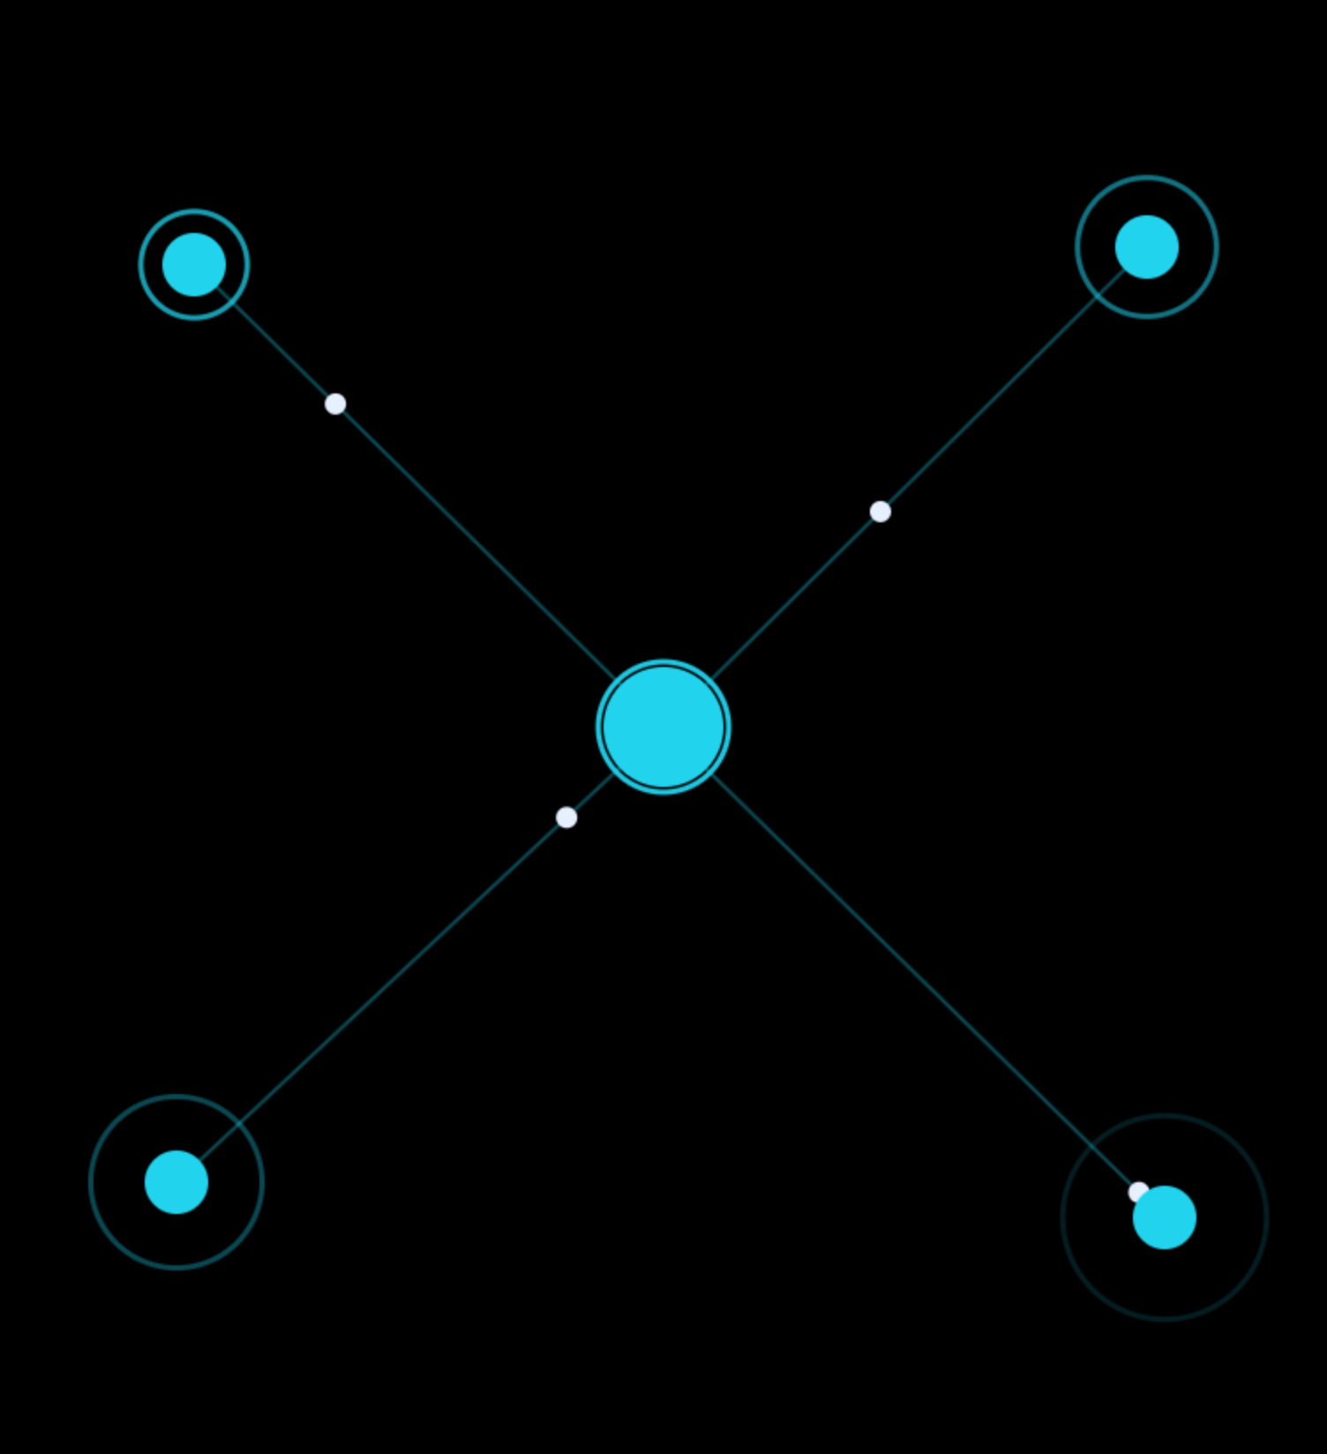
24-HOUR BUILDATHON
TRUSTMESH
Autonomous Trust & Machine-to-Machine IoT Network
SENSE → VERIFY → DECIDE → ACT → PROVE → TRANSACT → RECORD
TRUSTMESH is a system that lets machines decide whether to trust each other, act on that decision, and prove the action actually happened.

Slide 2
OUR SOLUTION · A TRUST LAYER FOR AUTONOMOUS MACHINES
We don't just prove that an event happened.
We prove that the machine detected it, trusted it, acted on it, and actually completed the action.
TRUSTMESH · 3/21

Slide 3
HOW IT WORKS · STEP BY STEP
What Happens at each step
1 · SENSE
The real robot (NEURICK-001) reads its sensors: temperature and humidity (DHT22), distance (HC-SR04), gas (MQ-135) and motion (PIR).
2 · VERIFY
The ESP32 calculates a trust score and an anomaly score for what it just saw.
3 · DECIDE
The trust engine chooses ALLOW or REJECT. High trust and low anomaly means ALLOW; low trust or a severe anomaly means REJECT.
4 · ACT
An authorized software action runs: Monitor, Security Response, Emergency Response or Safe Hold.
5 · PROVE
The system checks that the action really executed. This is the Proof-of-Action.
6 · TRANSACT
If trust is good, machines can buy and sell services using simulated credits.
7 · RECORD
Every step is saved in a hash-linked ledger that can't be quietly edited.
TRUSTMESH · 5/21

Slide 4
SYSTEM ARCHITECTURE
From sensor to dashboard
NEURICK-001 ESP32-S3
›
FastAPI backend
›
Trust engine
›
M2M network
›
SHA-256 audit
›
React dashboard
Serial telemetry on COM7 at 115200 baud feeds the backend, which drives trust, reputation, pricing and audit.
TRUSTMESH · 6/21

Slide 5
TRUST ENGINE
Evidence in, authorization decision out
Sensor evidence
Trust score
Anomaly score
Threshold
Readings and sensor health
Immediate authorization state
Behavioural deviation
Decision boundary
High trust and low anomaly: ALLOW. Low trust or severe anomaly: REJECT.
TRUSTMESH · 8/21

Slide 6
MACHINE REPUTATION
Trust decays and recovers from behaviour
NORMAL
MOTION
GAS
UNTRUSTED
+3
+2
+1
−10
Range 0–100: 90+ Excellent, 75–89 Stable, 60–74 Degraded, below 60 At Risk. Trust score is the immediate state; reputation is the longer history.
TRUSTMESH · 11/21

Slide 7
M2M MARKETPLACE
Trust-aware service pricing
REQUEST
›
VERIFY
›
ACT
›
PROOF
›
PAY
90+
75–89
60–74
Below 60
Trust discount
Normal price
Risk premium
Access blocked
Services: Environmental Scan, Obstacle Detection, Security Response, Emergency Gas Analysis. Wallet starts at 10.00 simulated credits; no real money moves.
TRUSTMESH · 14/21

Slide 8
THANK YOU

